Slide 1
75 Years
Brand and Social Guidelines

Slide 2
75 Years – Brand and Social media Guidelines
Purpose: To ensure consistent, aligned, high‑quality communication across all divisions during the 75‑year celebration.
Why These Guidelines Matter
Campaign Overview
Ensure consistency across all Programmed channels and divisions
Reinforce a unified brand look and narrative (visual + verbal)
Help teams post with confidence
Reduce off‑brand or misaligned ad‑hoc posts
Support cross‑division storytelling around shared heritage and future direction
Duration: Start now → End of October 2026
Scope: Corporate and divisional social content, internal comms, website links, milestone storytelling.

Slide 3
Core Narrative and Messaging Framework
Central Idea
Messaging Themes
Tone of Voice
“75 Years of…” – a flexible line each division can customise
Examples:
“75 Years of Connecting Customers and Communities”
“75 Years of Skilled for Success”
“75 Years of Partnerships That Last”
Heritage and stability
ANZ-wide presence and impact
Long‑term reliability
People, capability, safety
Future‑focused growth and partnership
Warm and people‑centred
Evidence-led (use real stories, moments, achievements)
Confident, authentic, future‑positive
No exaggeration; celebrate with humility

Slide 4
Visual Identity
Cohesive approach

Slide 5




75-Year Logo Lockup
The 75-Year logo is to be used together with our Programmed endorsed logo.
The idea is to highlight 75 years but make it simple enough to remove going forward.
Programmed is to remain the focus.

Slide 6
Coordination and approval
To ensure consistency and maximise impact:
All 75-year activities and communications must go through your respective Marketing team:
Maintenance: Amelia Wilson
Staffing: Penny Ashcroft
Property Services: Su-Mei Tang
Marketing will support alignment on messaging, timing and channels
Approved ideas may be featured in group communications or social media

Slide 7
We want to hear from you
Share your story

Slide 8

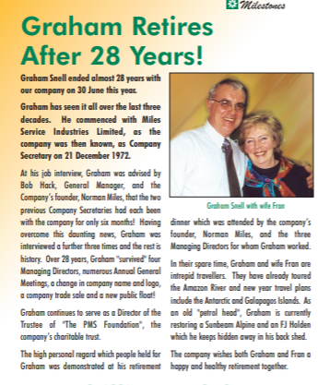
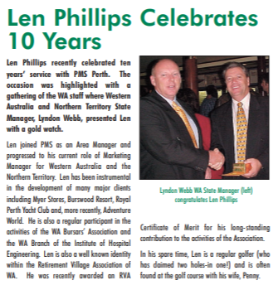
We want to hear from you
We encourage activities and stories that:
Celebrate people, teams and milestones
Highlight long-standing relationships or moments of impact
Reflect pride in our history while looking to the future
Can be shared internally and, where appropriate, externally
Feel inclusive and relevant across the broader business
Examples include:
Employee career stories or multi-decade tenure
“Then and now” photos or reflections
Local celebrations aligned to the group campaign
Customer or community stories that demonstrate long-term partnership

Slide 9
Sharing your story
Stories are a key part of our 75-year celebrations, and we encourage contributions from across the business.
When submitting a story, please include:
A brief description of the story and why it matters
How it connects to one or more messaging themes
Any photos or supporting material
Confirmation that anyone featured has given permission
Stories and images can be sent to communications@programmed.com.au

Slide 10
Thank you

